Slide 1

Open Source Data Processing with OpenDroneMap
EXERCISES
DroneCamp
July 28, 2021

Slide 2
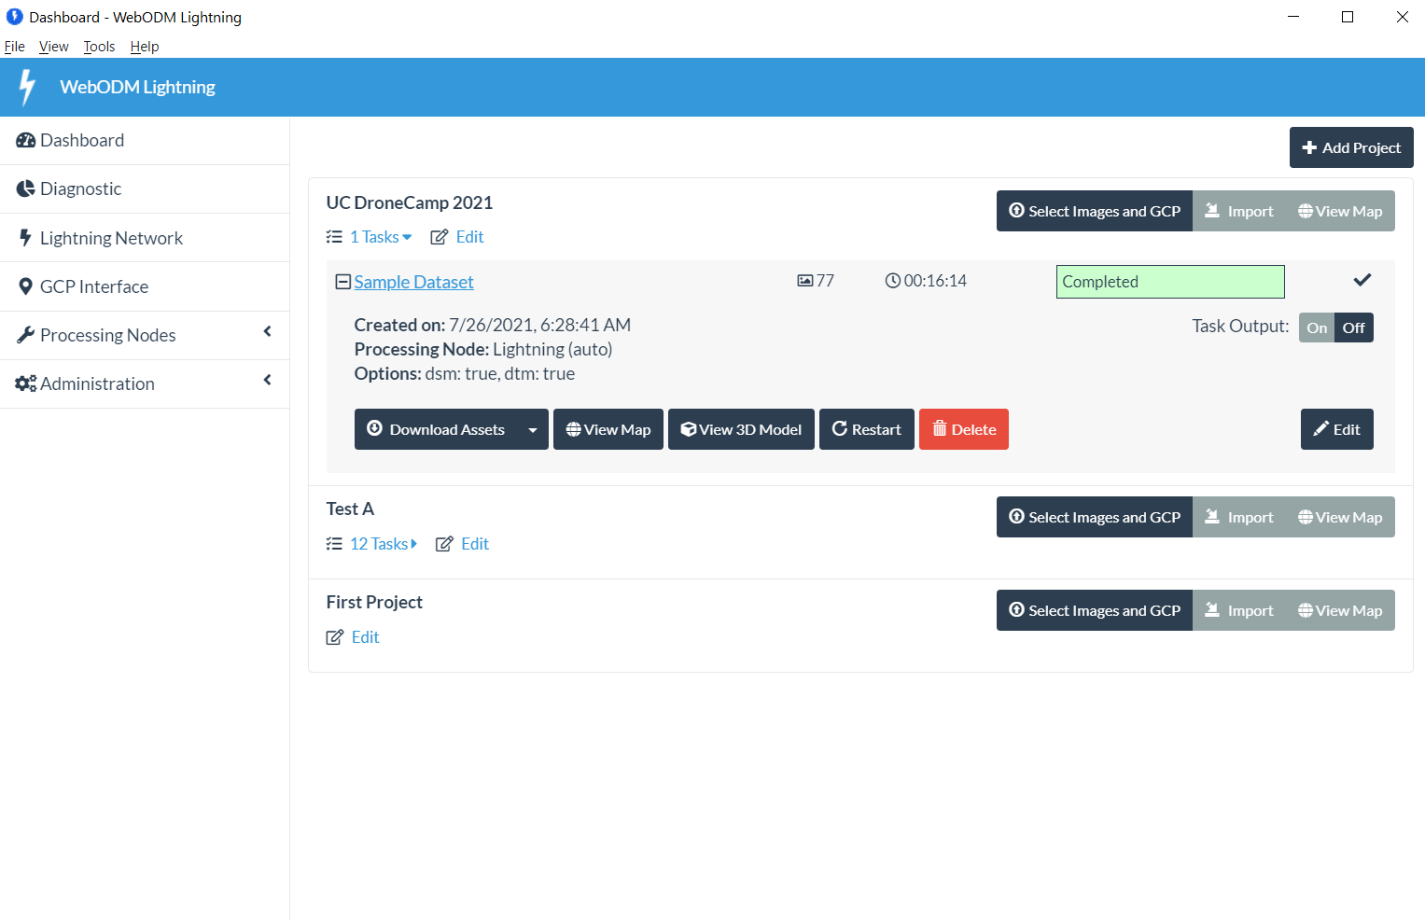
Exercises – 2D Orthophoto

Slide 3
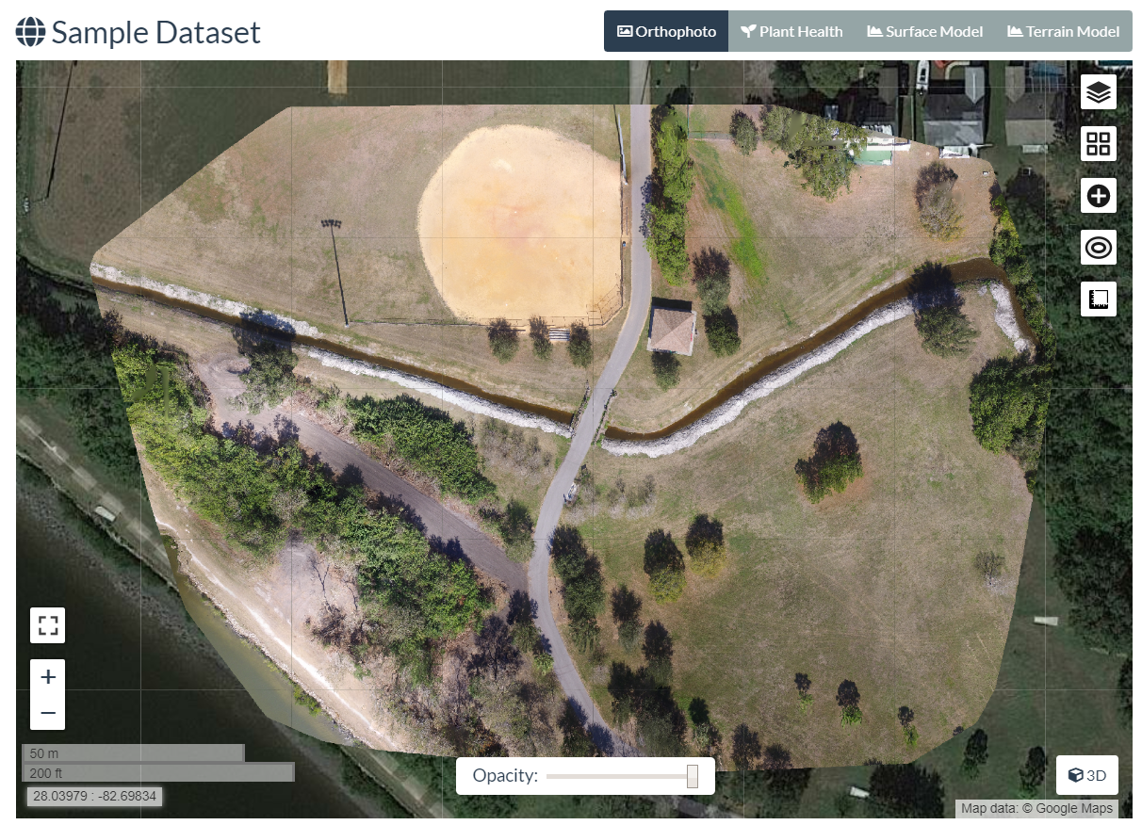
#1 – Orthophoto - Navigate
Click+hold = move map
Scroll wheel = zoom in/out
Map controls +/- = zoom
Map control square = full screen
Top buttons:
Ortho
Plant Health
Surface Model
Terrain Model

Slide 4
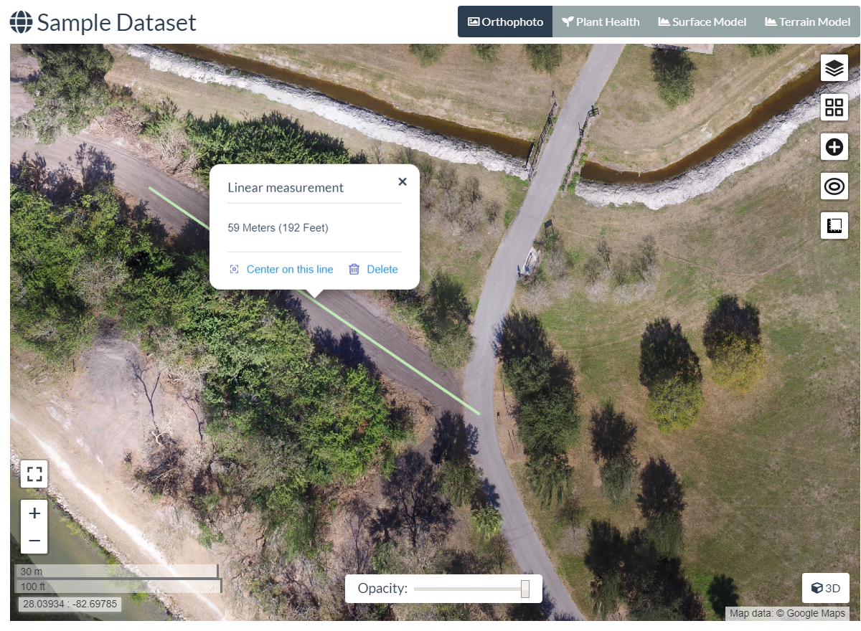
#2 – Orthophoto - Measure
Click ruler (5th on right)
Create new measurement
Click 2 points on map
Click “Finish measurement”
View calculations in white balloon
Close balloon with “x”
Click ruler again, new measurement
Click 4 points on map to make a box, click “Finish”
View calculations
Click “Delete” to remove it

Slide 5
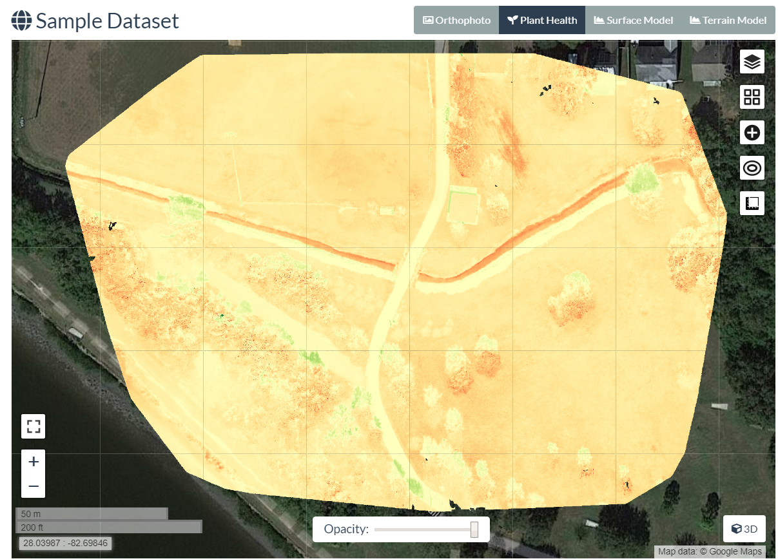
#3 – Plant Health
2nd Top Button: Plant Health
Note color differences in different grassy areas
Click top right “layers” icon
View “Algorithm” options
View “Color” options
Drag min/max bars
Export GeoTIFF

Slide 6
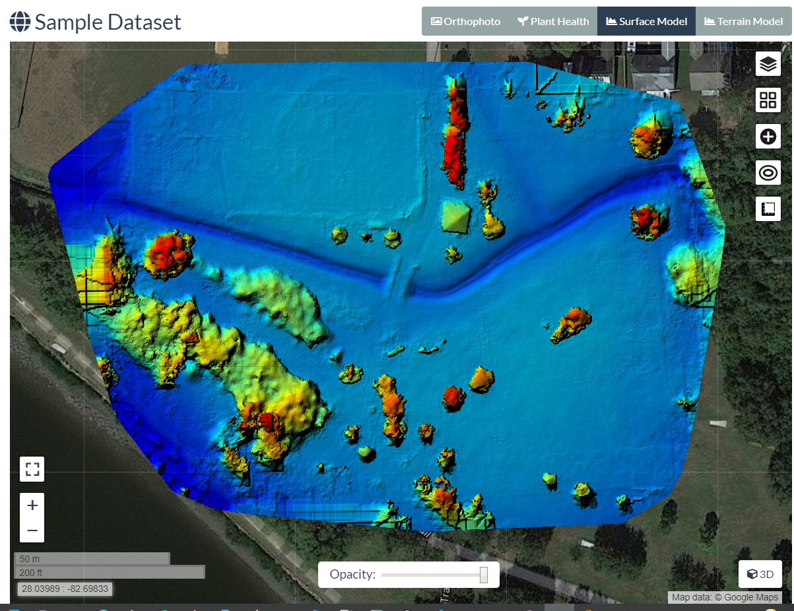
#4 – Surface Model (DSM)
3rd Top Button: Surface Model
Wait for calc/load
Note color varies by altitude
Click top right “layers” icon
View “Color” options
Drag min/max bars
Wait for refresh
Export GeoTIFF

Slide 7
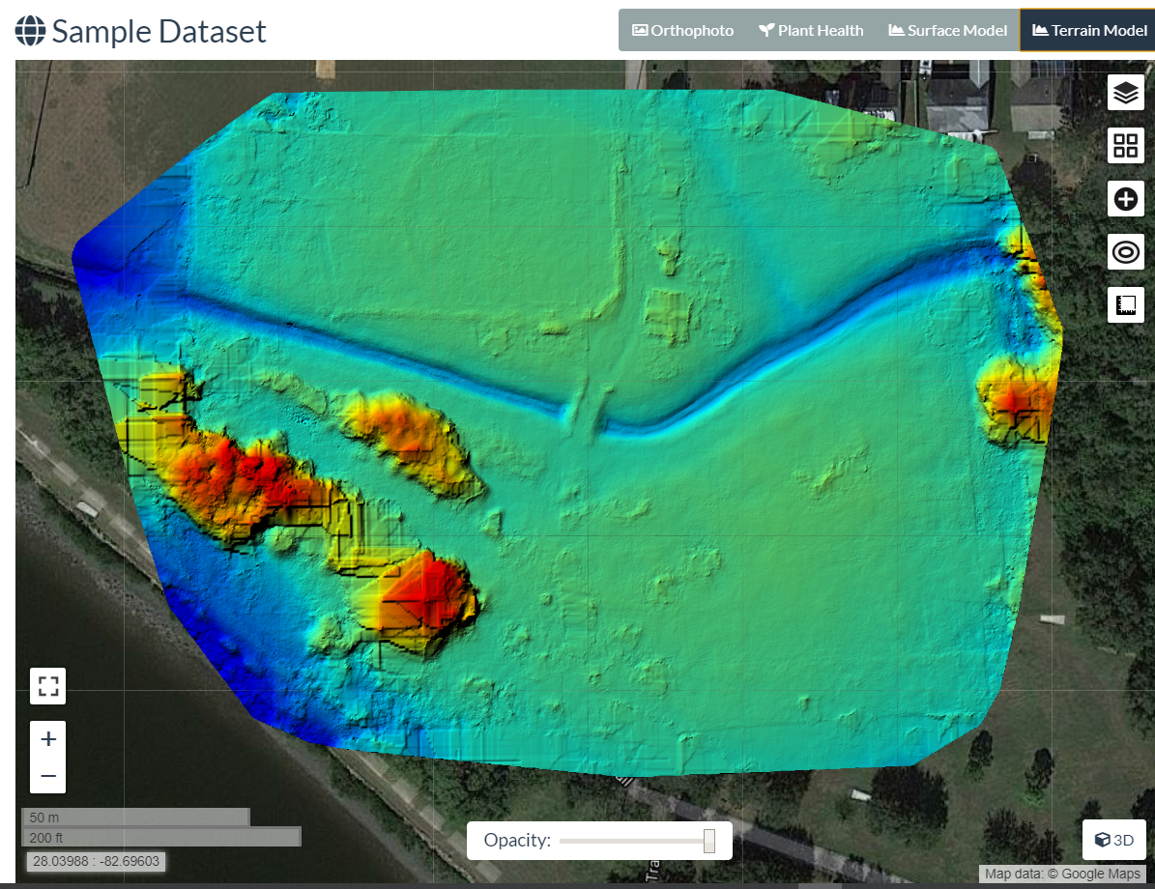
#5 – Terrain Model (DTM)
4th Top Button: Terrain Model
Wait for calc/load
Note color varies by altitude
Click top right “layers” icon
View “Color” options
Drag min/max bars
Wait for refresh
Export GeoTIFF

Slide 8
Exercises – 3D Model

Slide 9
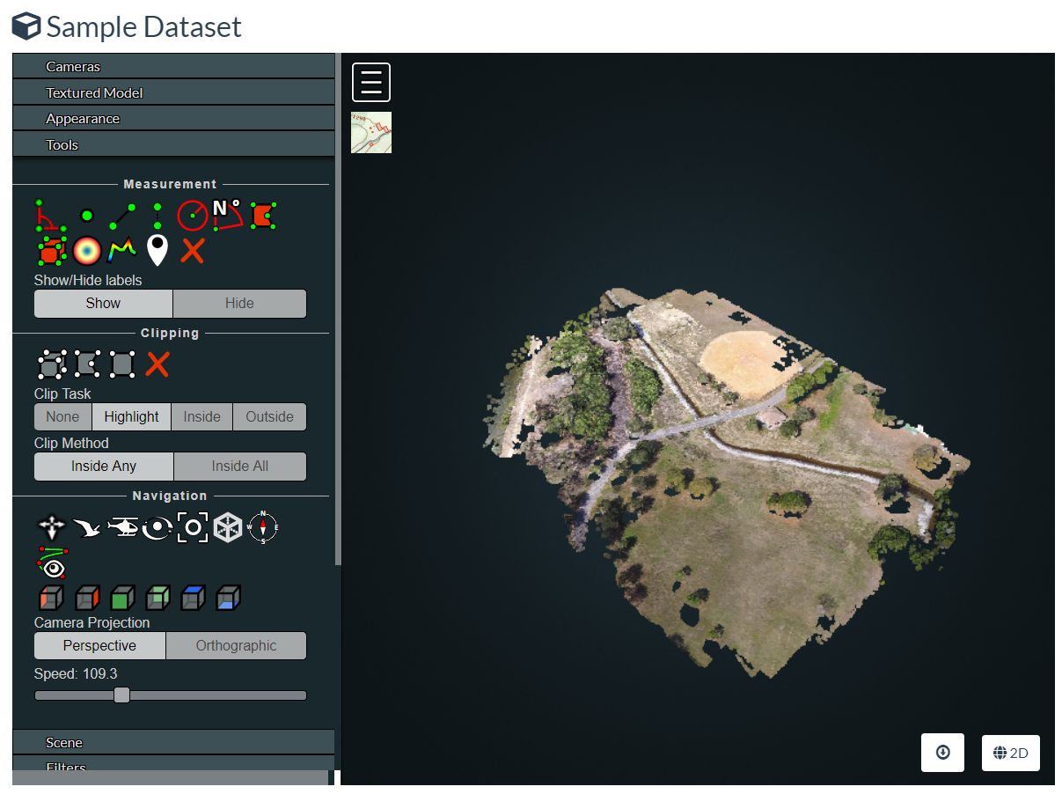
#6 – 3D Model - Navigate
Left click+drag = rotate model
Right click+drag = move model
Scroll wheel = zoom in/out
Top left (3 bars) button = collapse tools
Top left (map) button = show model location
Tools
Measure
Navigation
Appearance
Scene

Slide 10
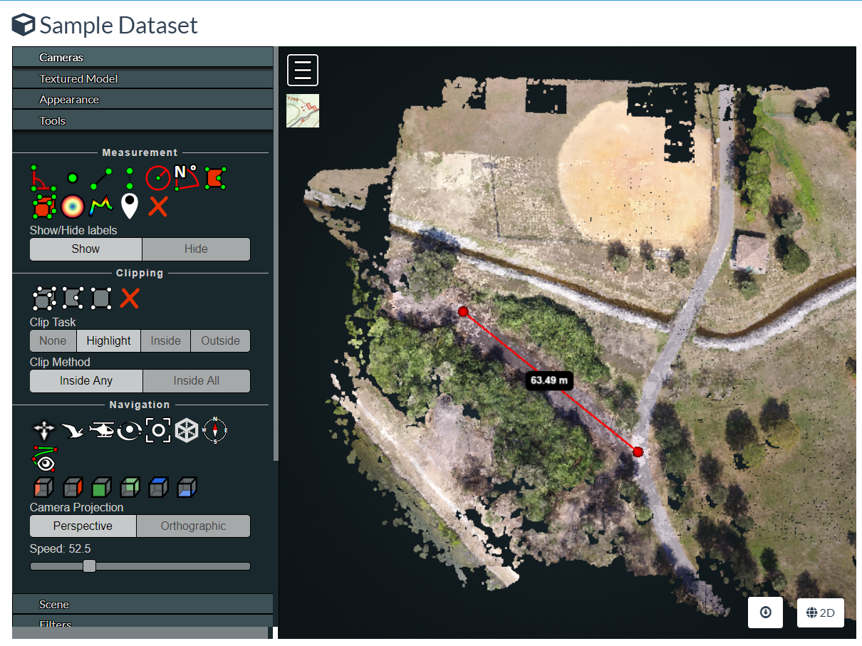
#7 – 3D Model – Measure (Linear)
Adjust the model so you can see
Click 3rd Measurement tool (angled line)
LEFT click 2 points on the map
Now RIGHT click the last point to finish
View measured distance (m)
Click red “X” in measurement tools, to delete

Slide 11
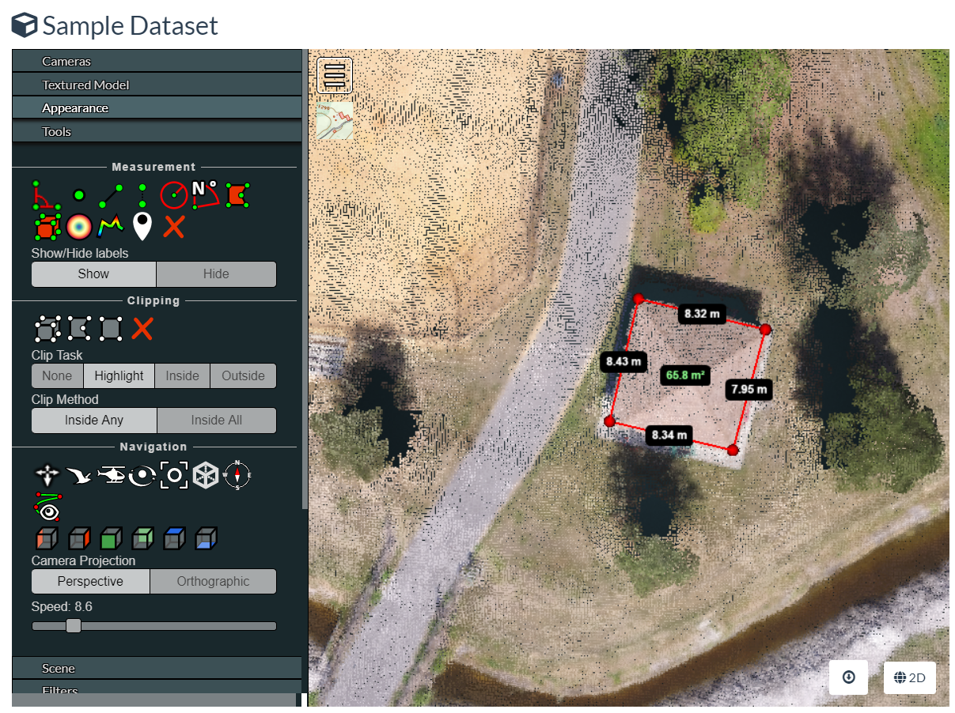
#8 – 3D Model – Measure (Area)
Adjust the model so you can see
Click top right Measurement tool (red box)
LEFT click 4 points on the map
Now RIGHT click the last point to finish
View measured distances (white)
View measured area (green)

Slide 12
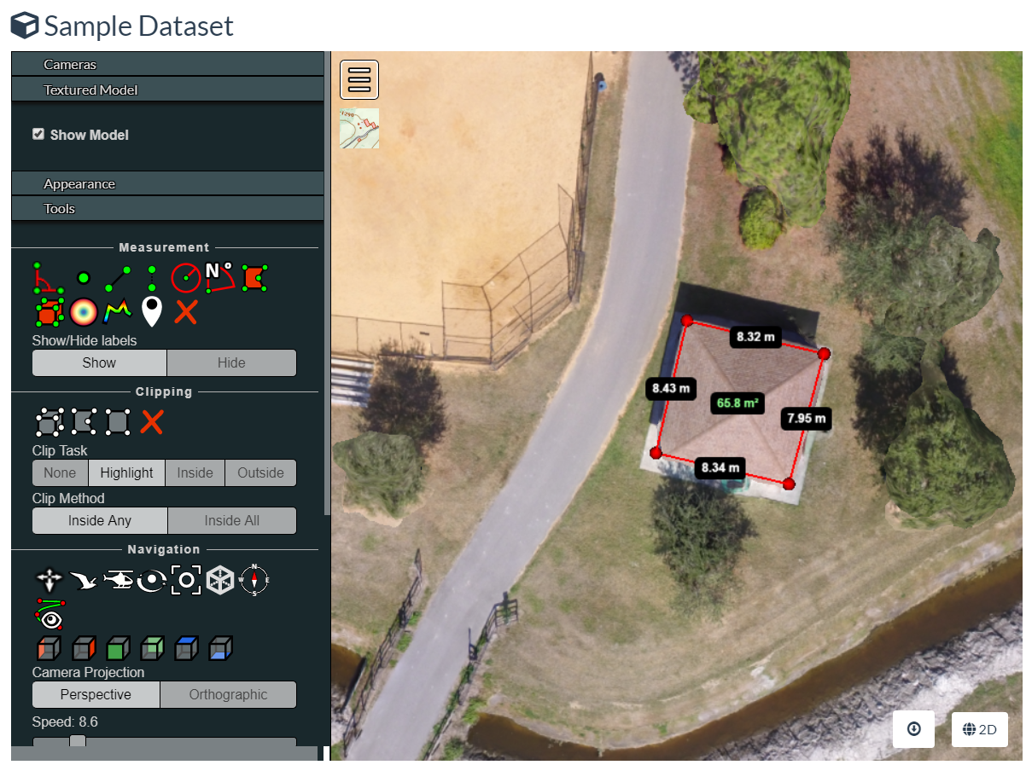
#9 – View Textured Model
Find “Textured Model” near the top of the tool menu
Click to expand, then click “Show Model”
Wait a few seconds
View how the scene becomes more detailed, holes are filled
Uncheck and check the box to turn off, and on
Move the model around to view other parts
Edges of model = lots of error Interior of model = better precision

Slide 13
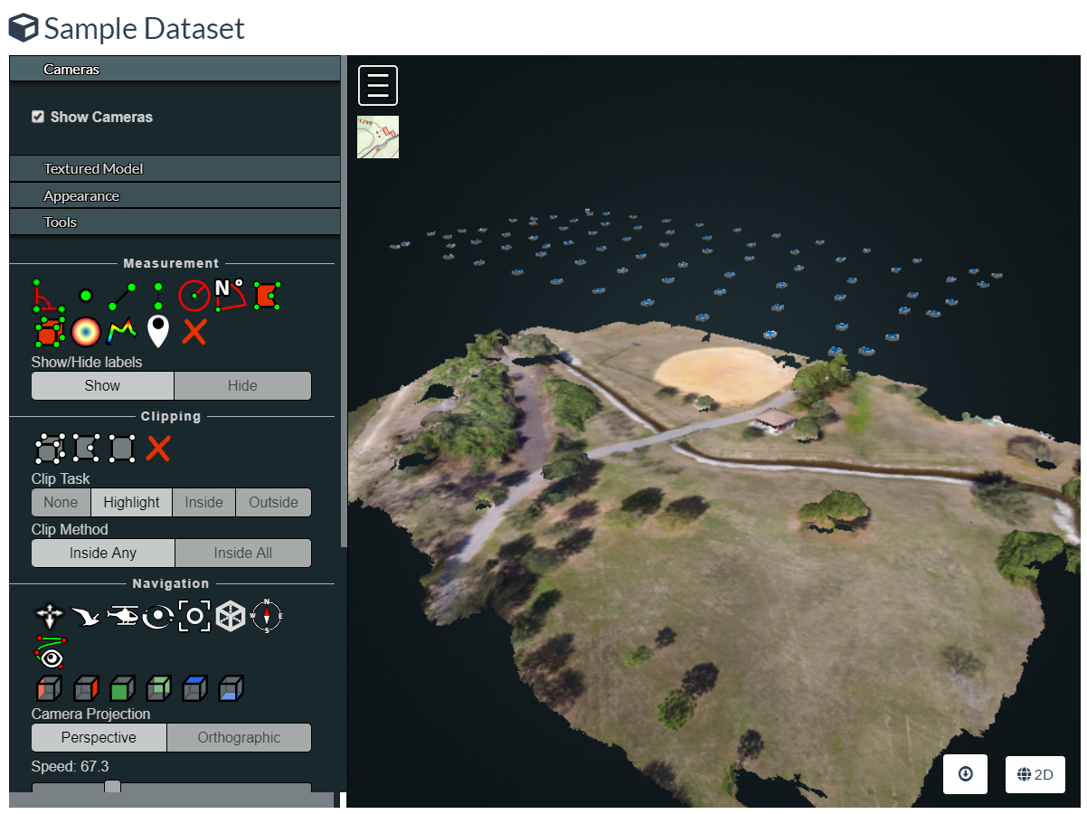
#10 – View Cameras
Find “Cameras” near the top of the tool menu
Click to expand, then click “Show Cameras”
Zoom out (scroll) until you see the blue squares floating above the scene
Note positions, angles of cameras
Click one camera to see the photo from that position

Slide 14
Exercises – Download

Slide 15
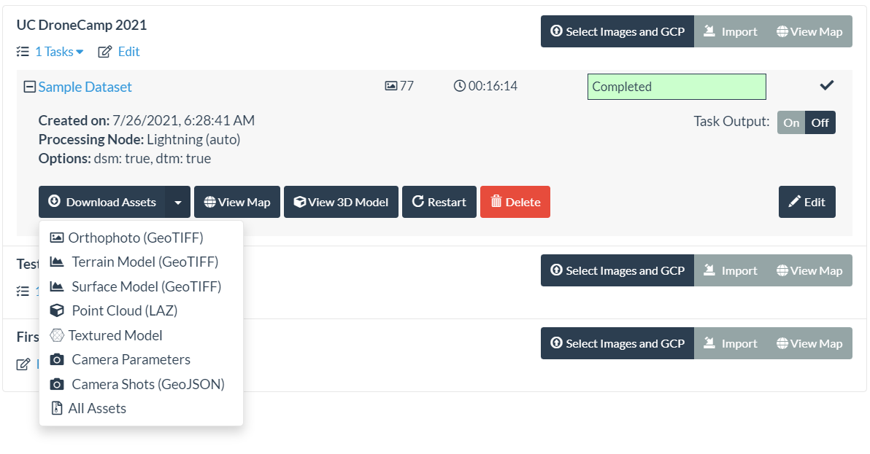
#11 – Download Specific Outputs

Slide 16

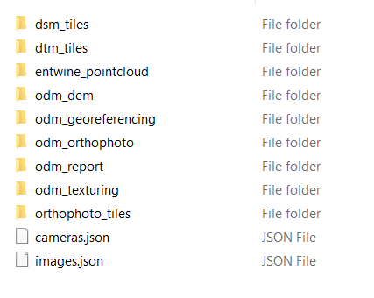
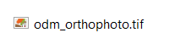
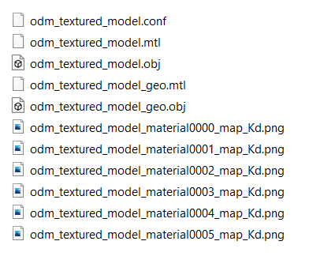
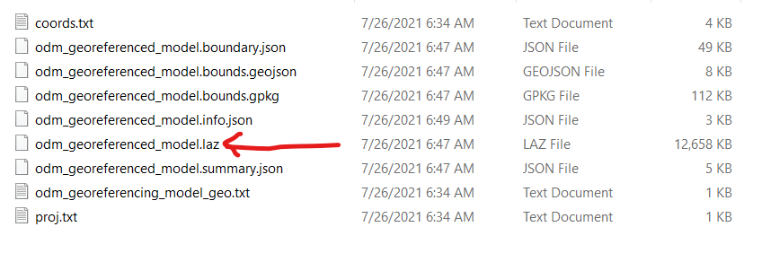
#12 – Download All

Slide 17


Contact Me
corey@twomile.com
https://www.linkedin.com/in/coreysnipes
This material is based on presentations by:
Stephen Mather - ODM, Cleveland Metroparks
Piero Toffanin - ODM, UAV4GEO
Screenshots and interface images by
Corey Snipes, unless otherwise noted.
coreysnipes
twomileheavy
Thank You!
https://opendronemap.org

